Slide 1

An adaptive tree structure for the discrete integration of the weak forms arising in the meshless simulation of elliptic equations
Dr Gabriel Fougeron
(Dr Argiris Kamoulakos)
ESI Group, Paris, France

Slide 2
Contents
Introduction
Integration: the problem with EFG
No refinement: how to deal with uniform point clouds
Two refinement algorithms for integration
A numerical application
Conclusions

Slide 3
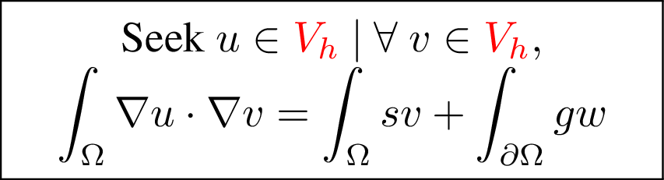
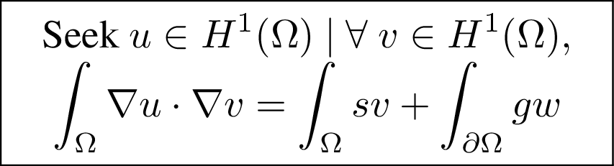
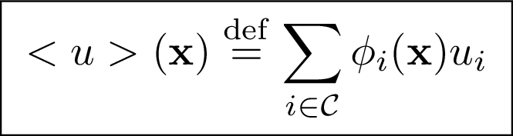
Introduction : What is EFG ? (Element Free Galerkin)
A typical elliptic problem in weak form: the diffusion equation
« Galerkin » ⬄ Restrict test and trial spaces to more manageable finite dimensional subspaces.
« Element-free » ⬄ These functions are build without reference to a mesh
Ex : MLS, RBF, Sibson & Laplace shape functions (to some extend), …
Test space
Trial space

Slide 4
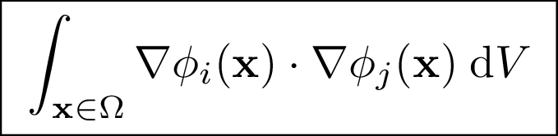
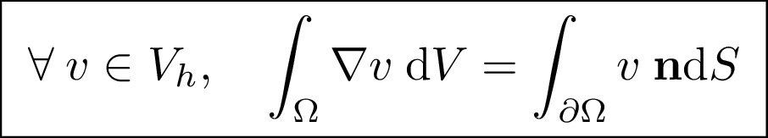
Some context : The problem with EFG
Matrix assembly ⬄ Compute these expressions:
Problem: Meshless ➔ not expressible in closed form!
Good convergence properties if approximation satisfies linear patch test conditions (cf [Bonet and Kulasegaram 2000] and [Babuska et al 2009]), namely:
Approximate derivatives should be first-order accurate
Discrete integration should satisfy the following Green’s theorem:

Slide 5
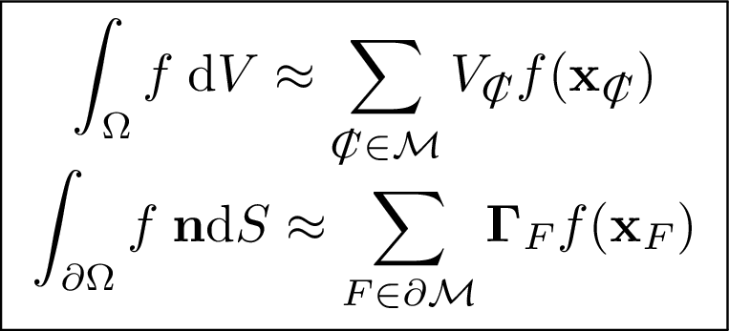
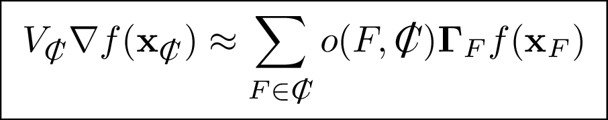
Some context : Mesh-based integration for EFG !
Barycentric integration approximation
Gauss gradient approximation
Capital result (cf our earlier work [Fougeron 2018]): Regardless of cell shape, size, # of edges/faces/nodes, in 2-D, 3-D and more …
Barycentric integration + Gauss gradient
➔ Linear patch test conditions

Slide 6
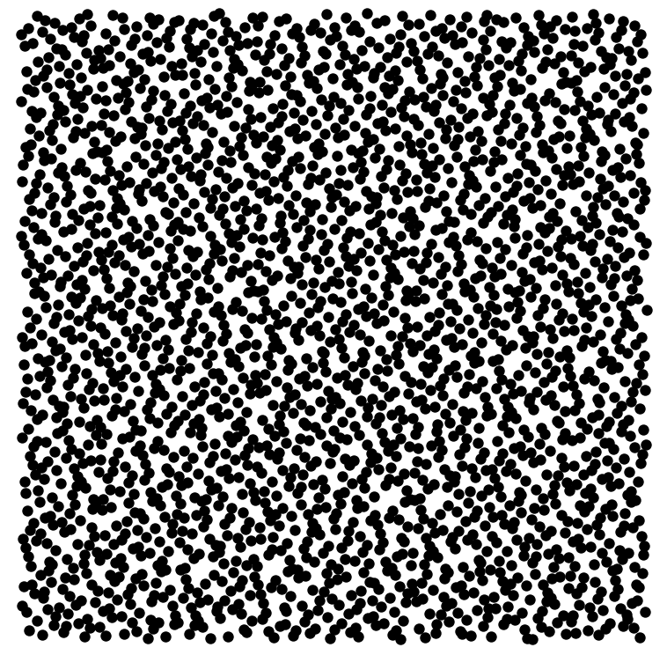
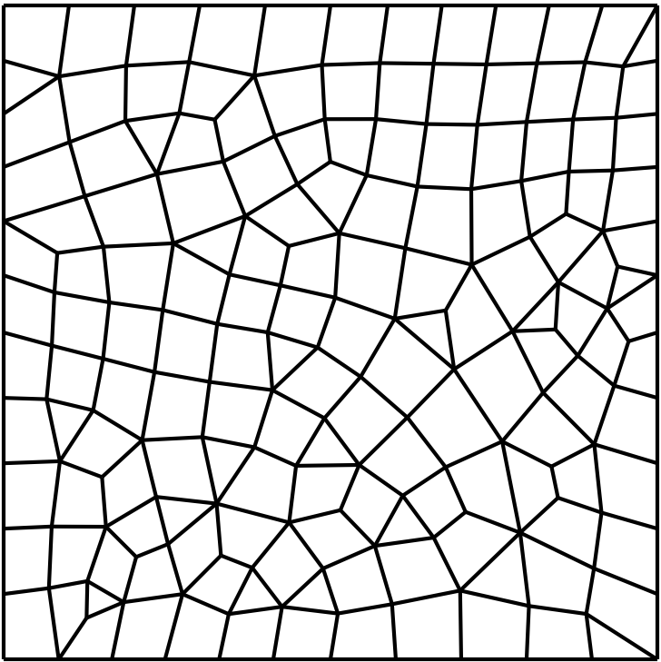
Some context : Point cloud and mesh play separate roles
Point Cloud
Mesh
Holds degrees of freedom
Definition of shape functions ➔ of the Galerkin weak form
Defines the geometry of the discrete domain
Compatible integration of the weak form
What constraints does the point cloud impose on the mesh?
Can we satisfy these constraints in an automatic and reliable fashion?

Slide 7
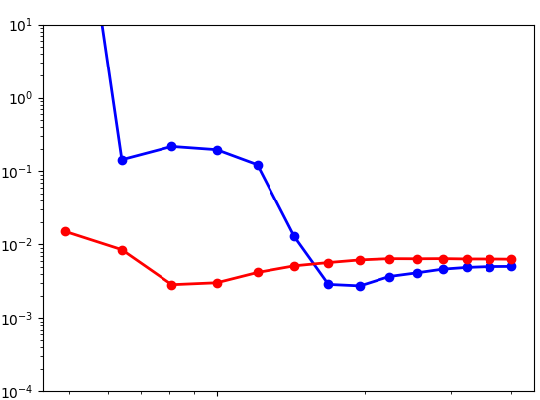
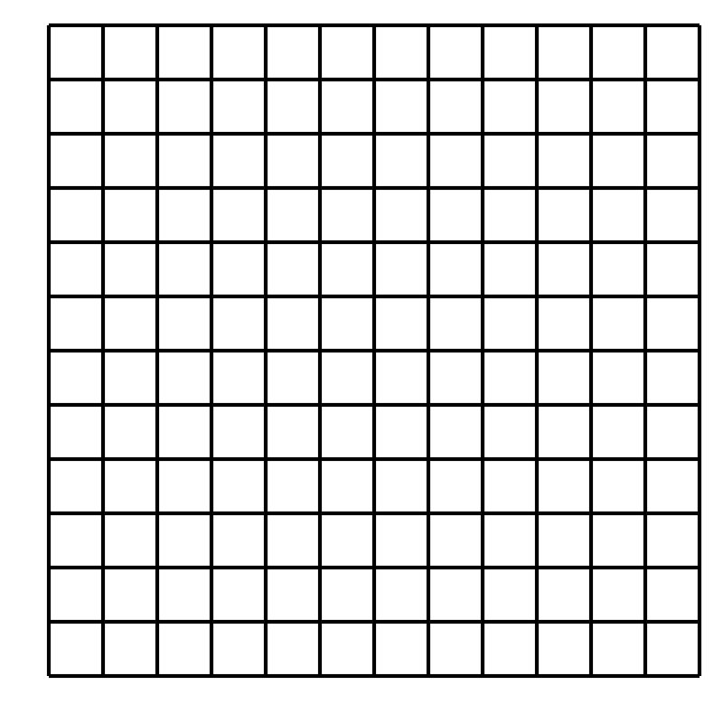
The easiest case: uniform point cloud density
Relative error on simulated flux
Patch-test compliant integration regardless of relative coarseness or cell shape!
➔Very fine meshes not useful
Mesh too fine ➔ High computational effort ➔ No accuracy gain
⚠ : Mesh too coarse ➔ Unstable discrete weak form
With stabilization
Without stabilization
~ 0.5 - 1 cells per node
Mesh density
Typical behavior of the simulation error
with a uniform point cloud as the mesh is refined
Halton pseudo-random nodal arrangement

Slide 8
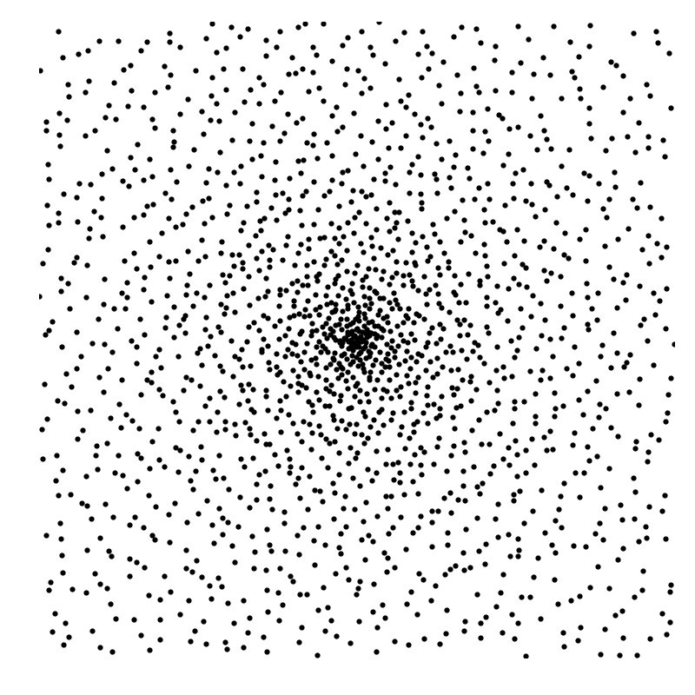
What about non uniform point clouds?
Goal: devise a mesh whose density matches that of a given point cloud.
Keep cells as « round » as possible (aspect ratio ~1)
We do not (yet) bother with the actual shape of the computational domain

Slide 9
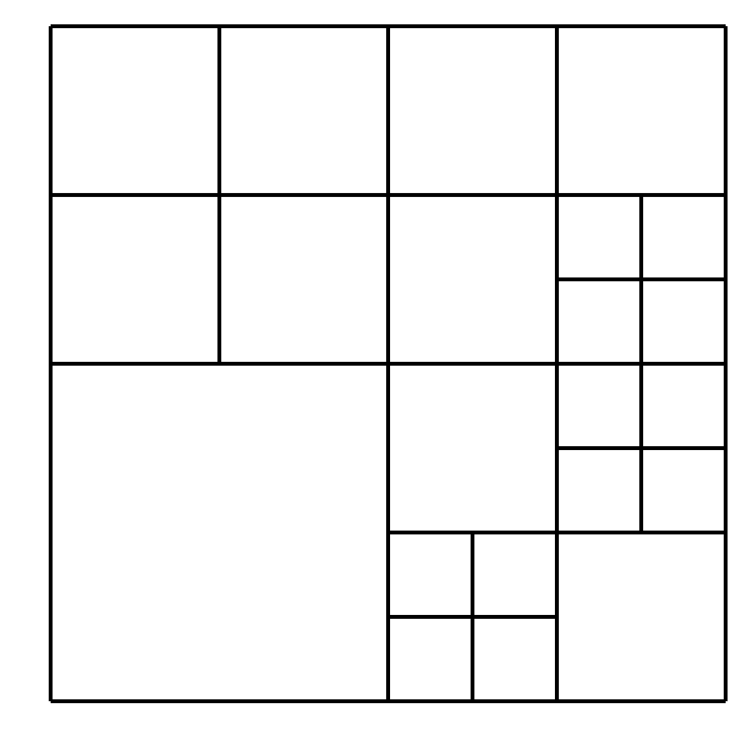
The « obvious » answer: 2d-trees
Tree structure:
Start from a square, and cut once along each spatial dimension
Every sub-cell has the shape of a square, process can thus be repeated
Suggests a simple algorithm:
Refine cell if it contains more meshless nodes than a given threshold
« Hanging nodes » are not a problem for barycentric integration. This cell has 7 faces and 7 nodes.

Slide 10
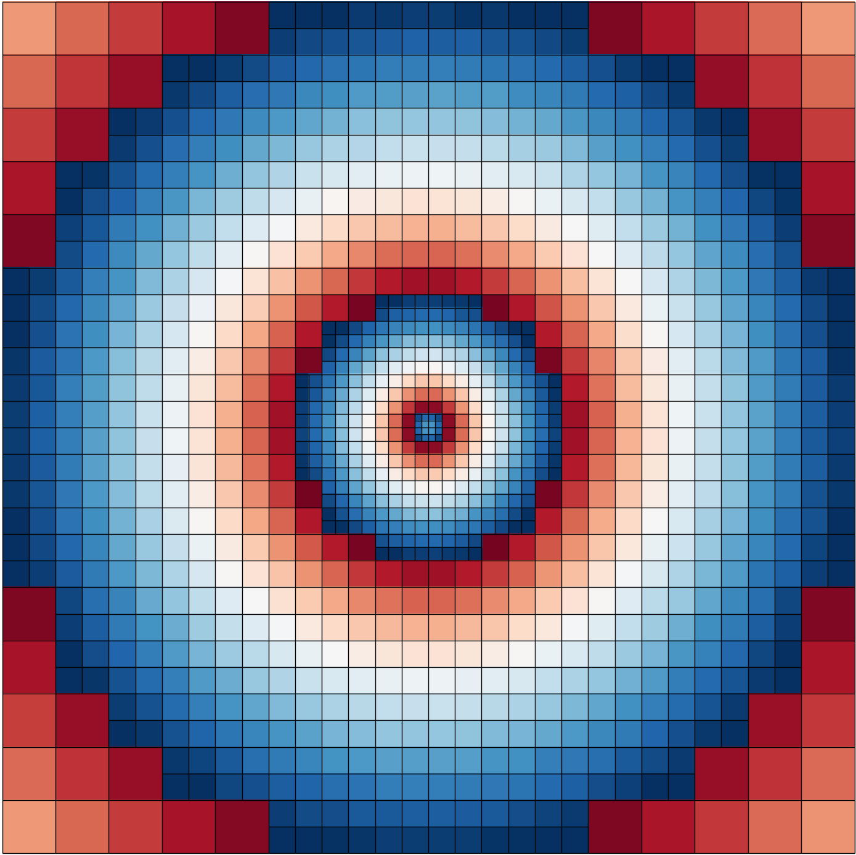
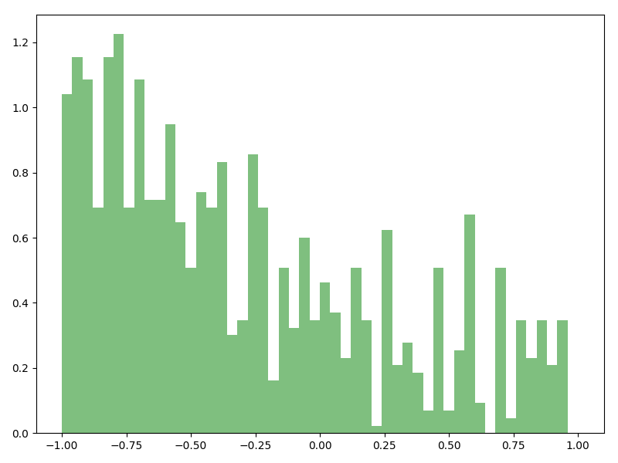
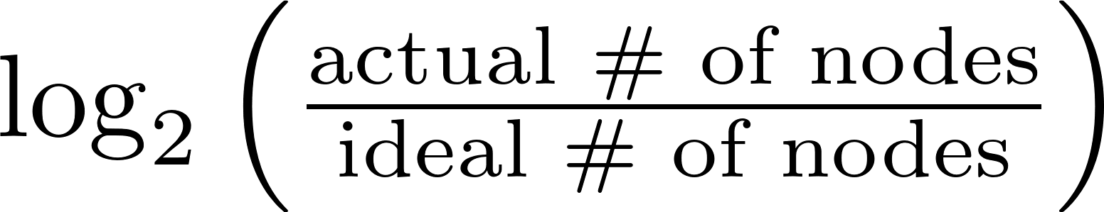
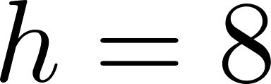
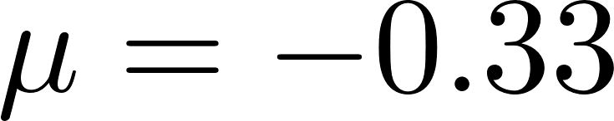
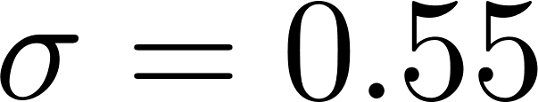
2d-tree algorithm behavior
Sharp transitions between:
Over integrated zones in blue
Under integrated zones in red

Slide 11

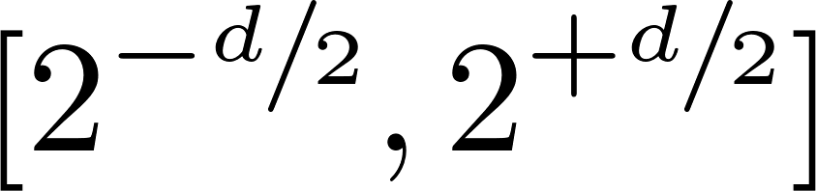
2d-tree algorithm: pros and cons
☺
☹
The ratio of actual to ideal number of nodes per cell remains in the interval
Cells are never elongated (unit aspect ratio)
Top-down algorithm: past choices are never re-evaluated ➔ Very fast & easily paralellizable
Each cut is of the form ➔ Maximizes tree height
Relative density histogram is very flat
Very sharp transitions in cell density ➔ 2d-trees lack flexibility

Slide 12
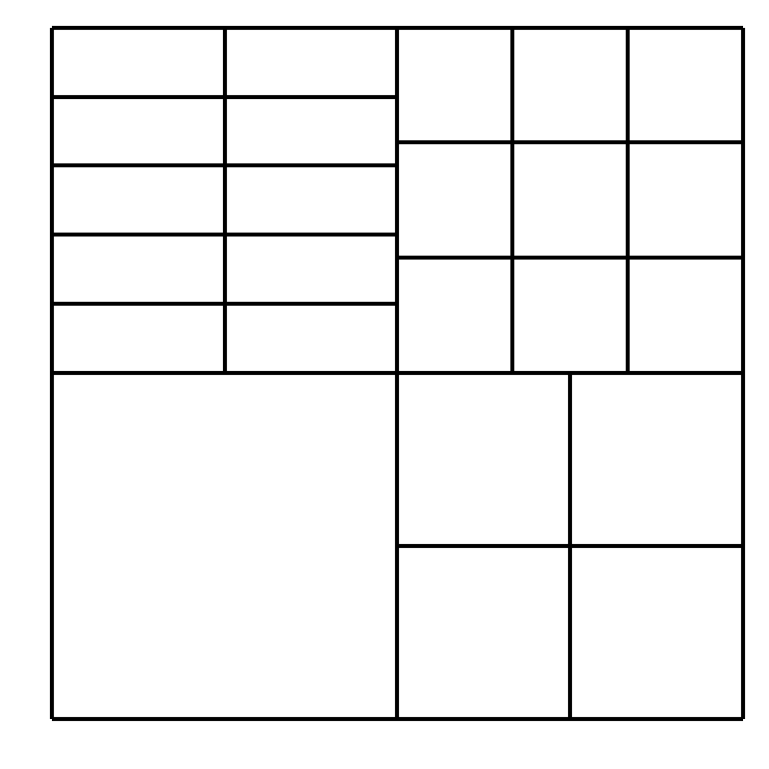
Softening the transition: general cartesian trees
General cartesian trees: allow arbitrary integer cuts along each dimension
Not really more difficult to implement

Slide 13

Our refinement algorithm: main idea 1/2
Find « square enough » cuts such that:
1-shot algorithm: Define
Implicitly assumes uniform distribution ➔ Completly defeats the purpose of adaptability!
Idea : What about two nested 1-shot passes ?

Slide 14
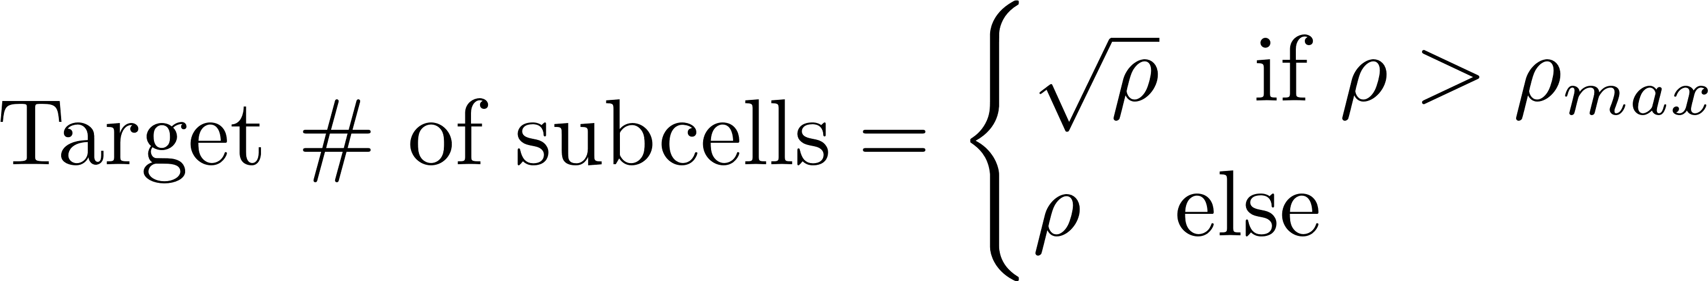
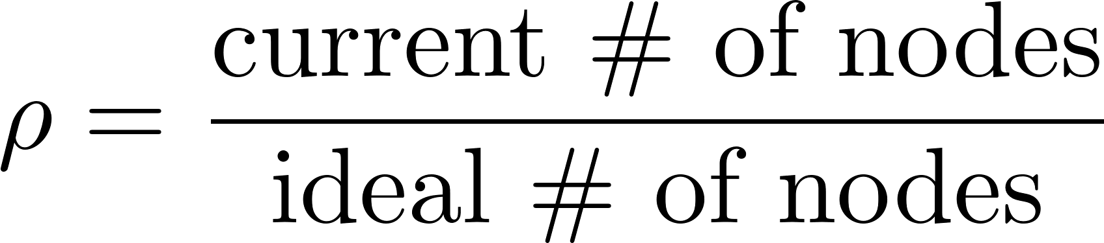
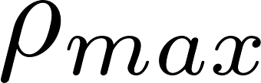
Our refinement algorithm: main idea 2/2
Find « square enough » cuts such that:
Half-way algorithm: Define
The compromise between adaptivity and tree height is governed by the value of

Slide 15
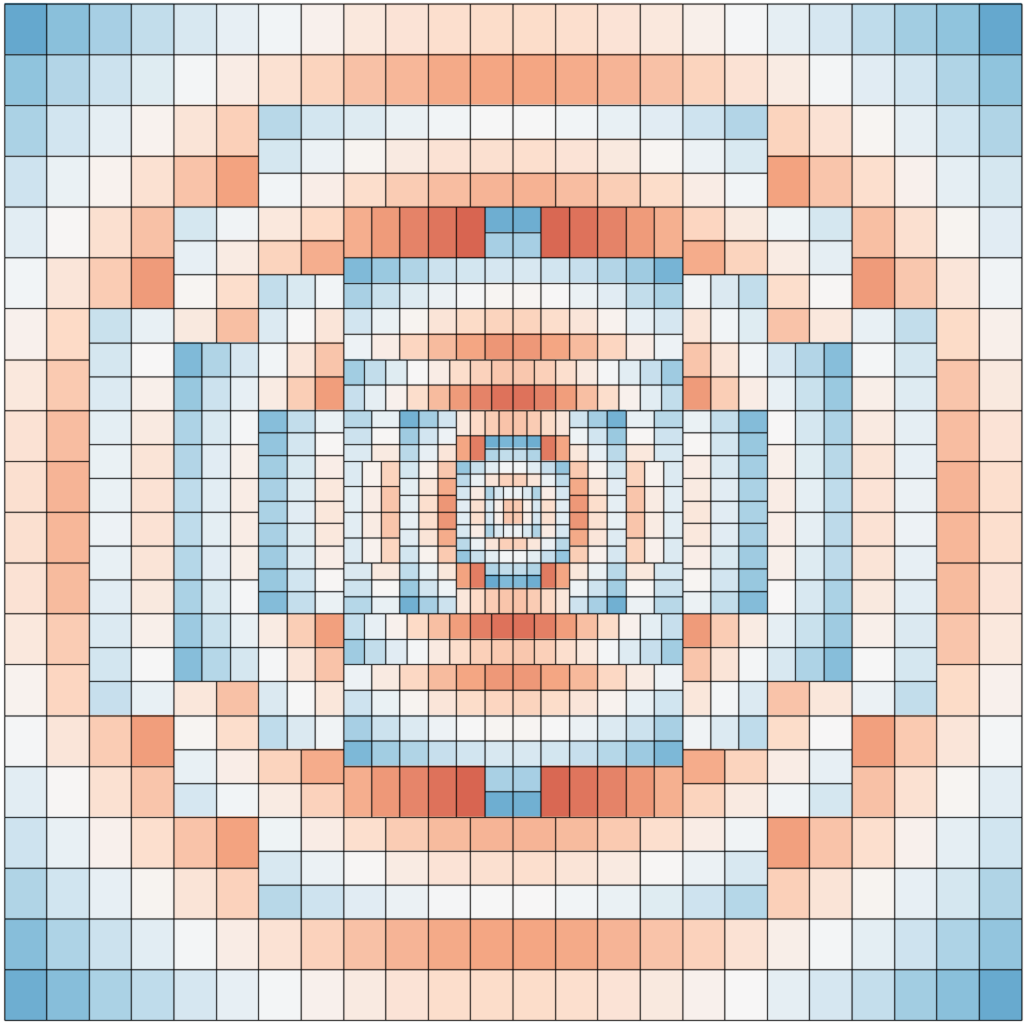
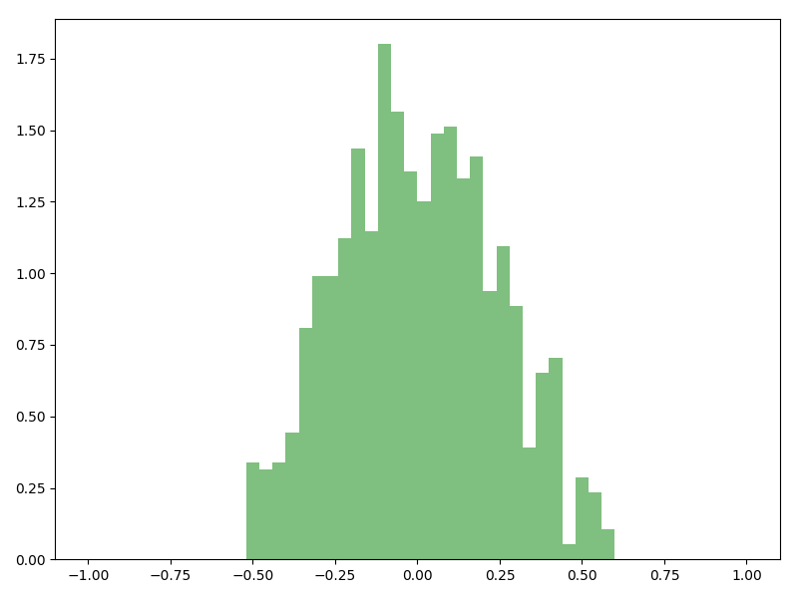
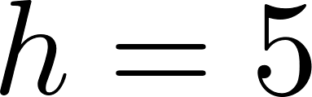
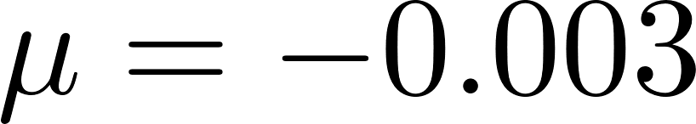
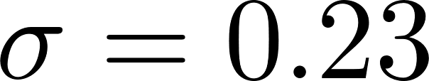
General cartesian tree algorithm behavior
Softenend transitions between:
Over integrated zones in blue
Under integrated zones in red

Slide 16
General cartesian trees algorithm: pros and cons
☺
☹
Improved statistics for the ratio of actual to ideal number of nodes per cell ➔ Histogram is narrower and better centered, tree height lowered, total number of integration cells and faces lowered
Top-down algorithm: past choices are never re-evaluated ➔ Very fast & easily paralellizable
Cells do not remain perfectly square
Cell interfaces can be messier ➔ Ratio of number of faces to number of cells increased from ~2.08 to ~2.23.
Measured average CPU timings are extremely similar … so why bother ?

Slide 17
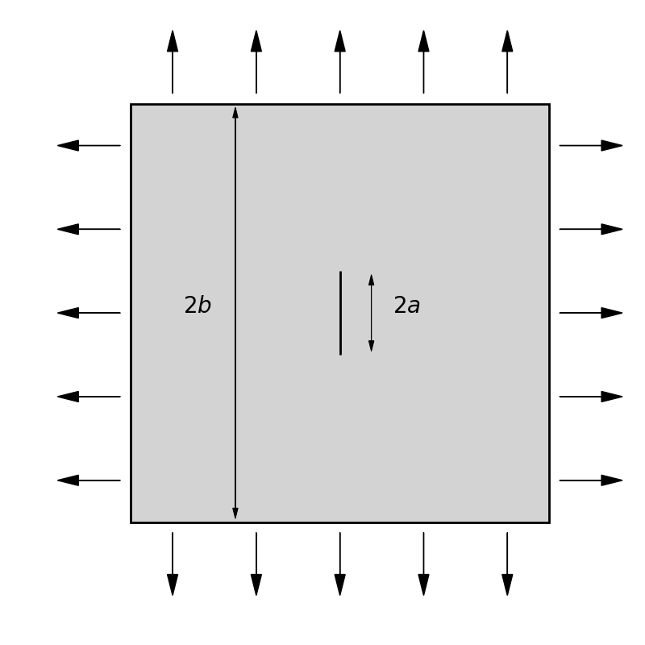
A numerical application
2-D test case: linear elastic finite crack under bi-axial tension
Boundary conditions chosen to match analytical solution
Symmetry ➔ Only top right quarter is simulated

Slide 18
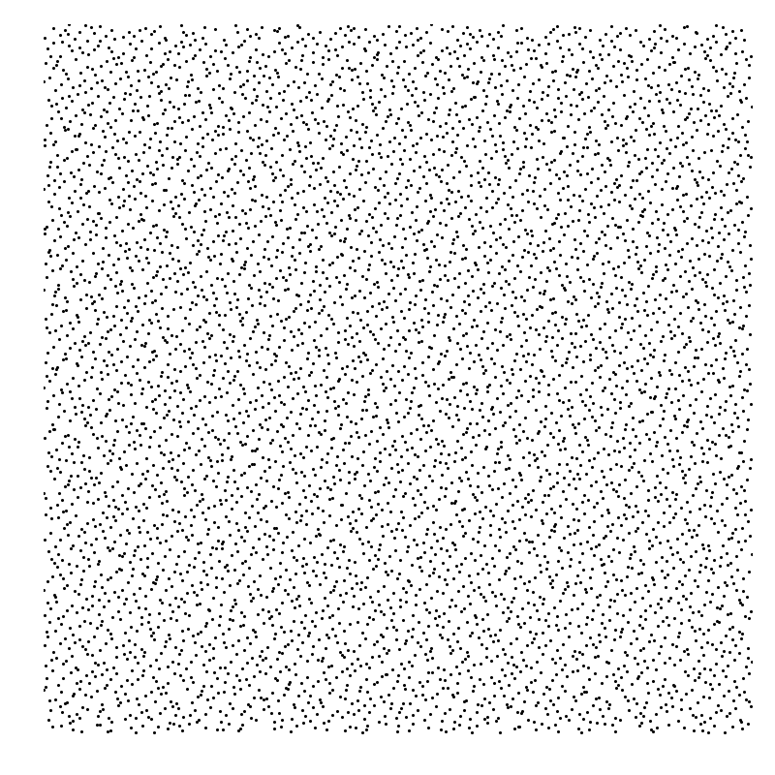
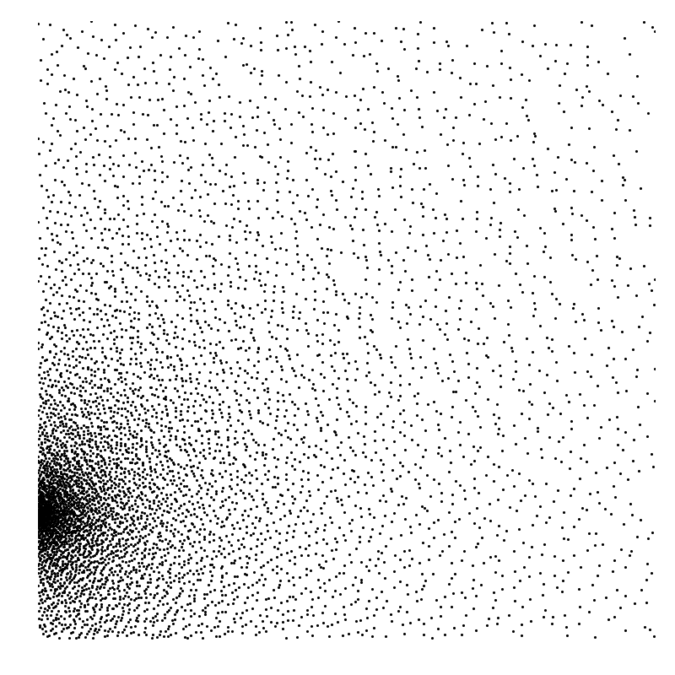
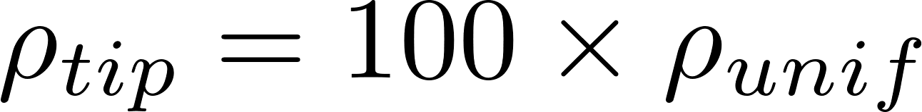
Local refinement near crack tip (Undeformed mesh)
Uniform Halton distribution
Increased density at crack tip

Slide 19
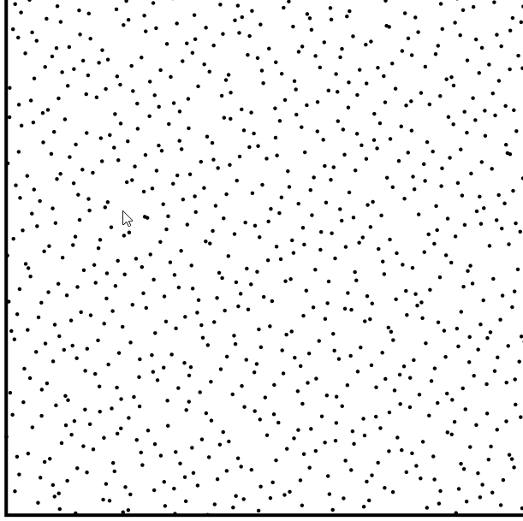
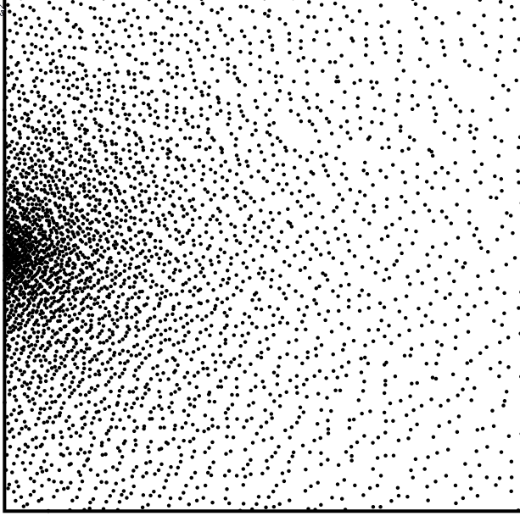
Increased resolution at crack tip (Undeformed mesh - Zoom)

Slide 20
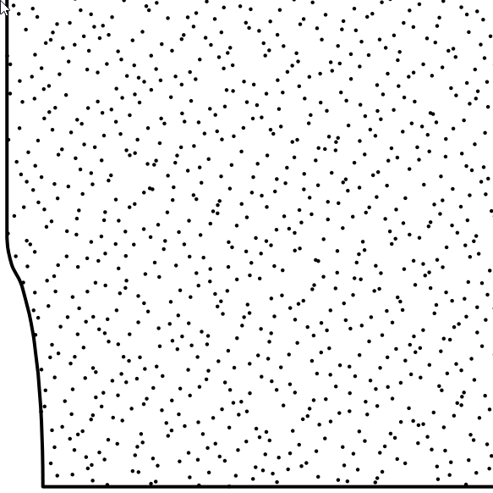
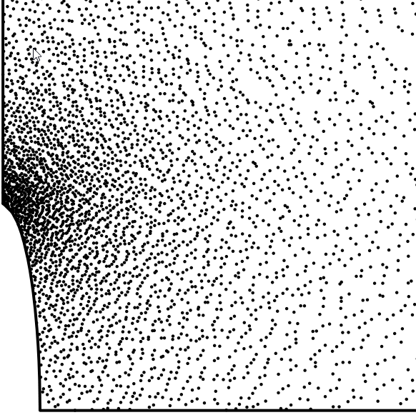
Increased resolution at crack tip (Deformed mesh - Zoom)

Slide 21
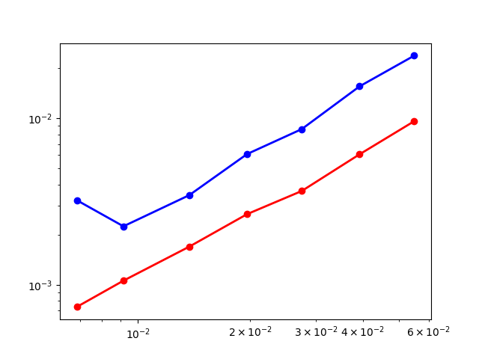

Increased accuracy of the stress tensor
Blue curve: uniform mesh
Red curve: non uniform mesh
Same convergence rate
Accuracy increased by a factor ~3
Mean relative error on stress tensor

Slide 22
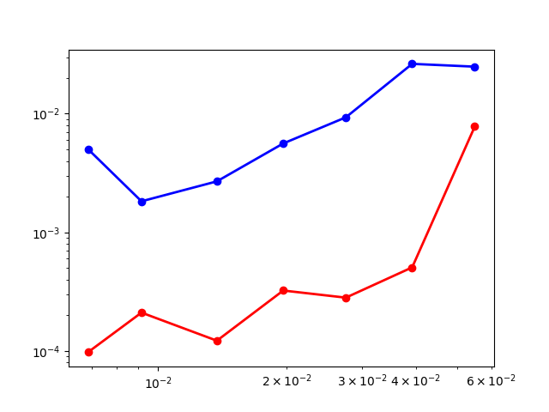
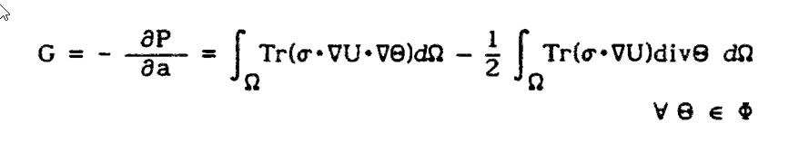
Better evaluation of stress intensity factor
Blue curve: uniform mesh
Red curve: non uniform mesh
The accuracy of the SIF evaluation with the theta method increased by a factor ~ 20 !
Relative error on stress intensity factor

Slide 23
Conclusions
Using a background mesh for the integration of the meshless Galerkin weak form ensures patch test compliance
Mesh and cloud density should roughly match
Two automatic mesh refinement algorithms were proposed
The general cartesian tree achieved better distribution statistics that the more naive 2d-tree, but this did not translate to improved CPU timings
Local point cloud refinement increases sharpness and accuracy of results

Slide 24

Thank you for your attention gfo@esi-group.com

